Slide 1

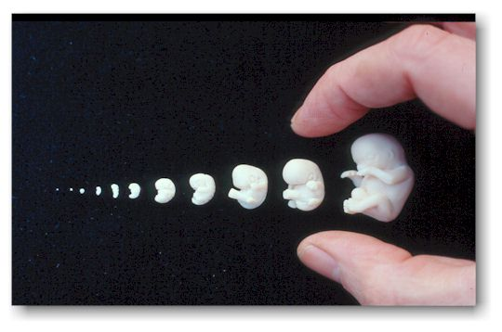
RUNGTA COLLEGE OF DENTAL SCIENCES & RESEARCH
Embryology (Development) of Face & Orofacial structures
DEPARTMENT OF ORAL PATHOLOGY

Slide 2
Specific learning Objectives
Core areas* | Domain ** | Category #
Neural crest cells | COGNITIVE | MUST KNOW
Branchial arches and pouches Development of lower and upper lip Development of nasal passages | COGNITIVE COGNITIVE COGNITIVE | MUST KNOW MUST KNOW MUST KNOW
Development of palate Development of cheeks Development of jaws Development of tongue | COGNITIVE COGNITIVE COGNITIVE COGNITIVE | MUST KNOW NICE TO KNOW MUST KNOW MUST KNOW

Slide 3
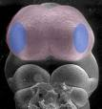
  CONTENTS
  Development of face
  Introduction
    Neural crest cells
    Branchial arches and pouches
    Development of lower lip
    Development of upper lip
    Development of nasal passages
    Development of palate
    Development of cheeks
    Development of eye
    Development of tongue

Slide 4
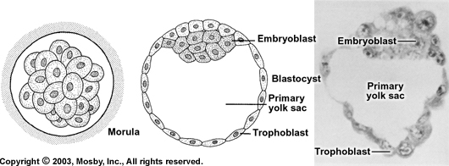
Differentiation of the Morula into Blastocyst

Slide 5
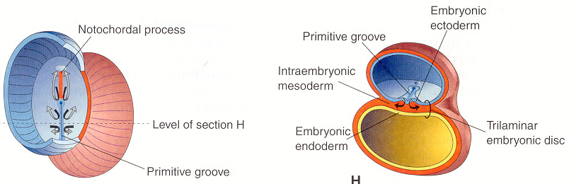
Formation of Three-Layered Embryo: Gastrulation (3rd week)
Ectoderm
Mesoderm
Endoderm

Slide 6
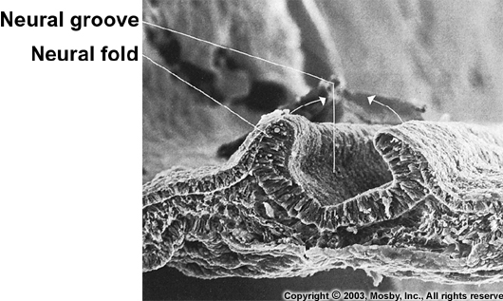
ECTODERM
NOTOCHORD

Slide 7
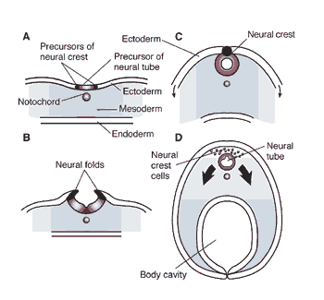

Slide 8
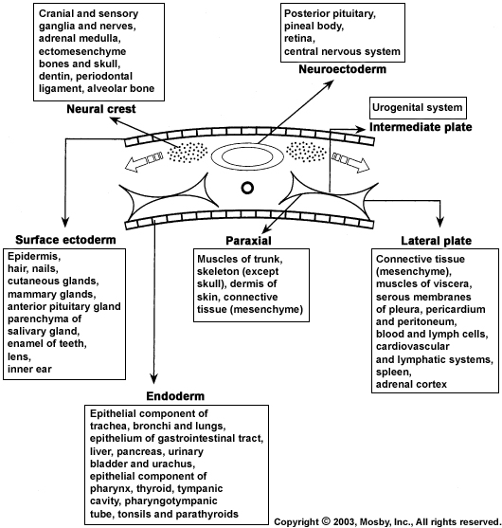

Slide 9
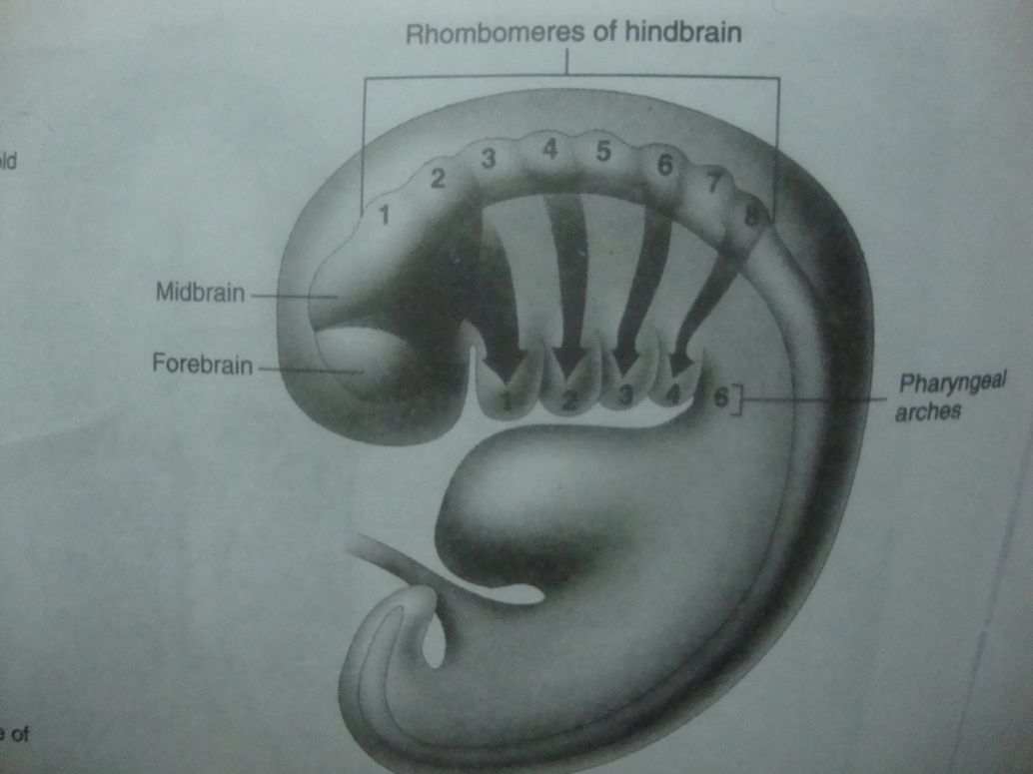
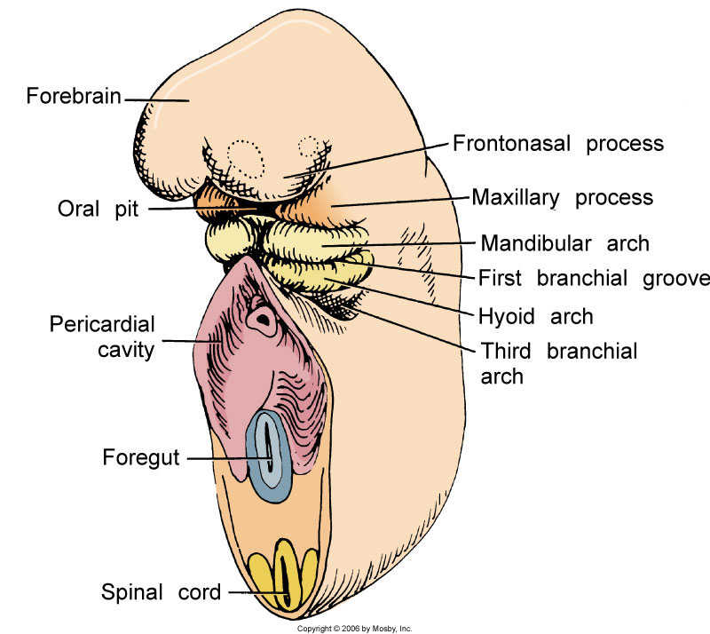
PHARYNGEAL ARCHES
Neural crest from the midbrain contribute specifically to the face and first pharyngeal arch structures
Notes:
Paths of neural crest migration to the developing face and pharyngeal arches (sagittal view). Neural crest cells from the midbrain and the eight rhombomeres of the hindbrain migrate along the arrows to the face and pharyngeal arches where they provide embryonic connective tissue. Neural crest from the midbrain and first two rhombomeres contribute specifically to the face and first pharyngeal arch structures.
9

Slide 10
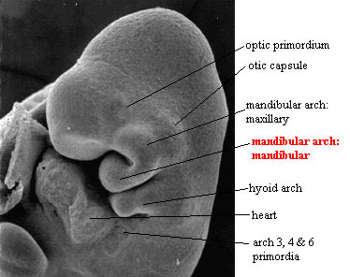
FIRST PHARYNGEAL ARCH
Mandibular arch
41 to 45th days post conception.
It is precursor of both:
Maxillary & Mandibular jaws and
bounds the lateral aspects of the stomatodeum
Notes:
The maxilla is derived from a small maxillary prominence extending cranioventrally from the much larger mandibular prominence derived from 1st arch .
Most of its cartilage substance disappears in the formed mandible.
The mental ossicle is the only portion of the mandible derived from meckle’s cartilage by endochondral ossification .
10

Slide 11
Formation of Face
4th week
After the formation of head fold, two prominent bulgings are formed
Developing
brain
pericardium
Separated by Stomatodeum
(Future Oral Cavity)

Slide 12
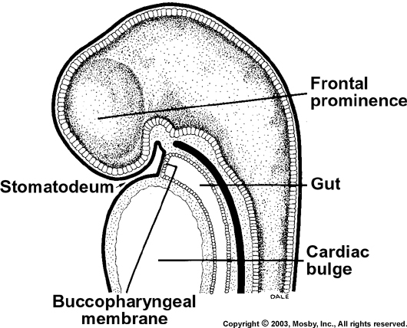
Embryo – 4th week

Slide 13
3 weeks

Slide 14
Formation of Face
Frontonasal process
+
1st pharyngeal (mandibular)
arch
Formation of face

Slide 15
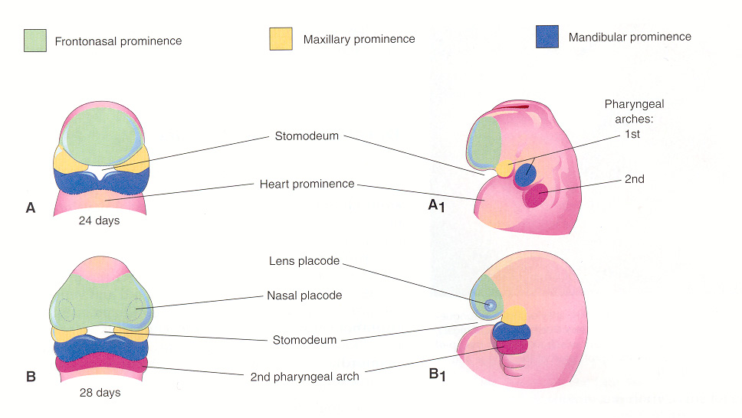
Development of the Face
The face develops between the 24th and 38th days of gestation
On 24th day, the 1st branchial arch divides into maxillary and mandibular processes / prominence

Slide 16
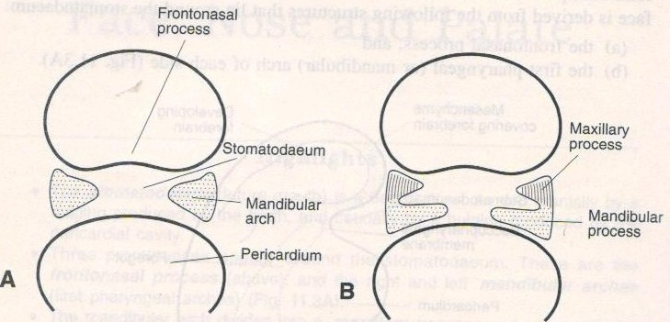
Thus at this stage, Stomatodeum is overlapped:-
  Above by Frontal process
  Below by Mandibular process
  On either side by Maxillary process

Slide 17
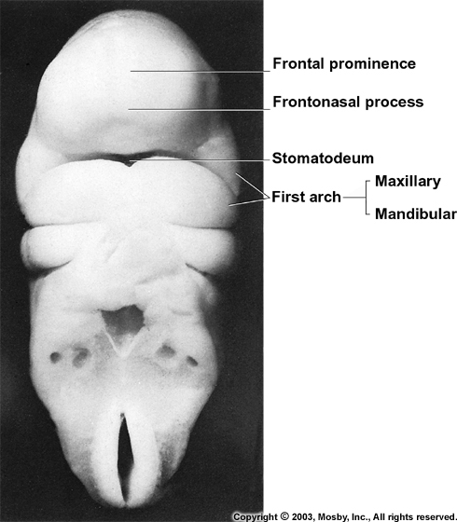

Slide 18
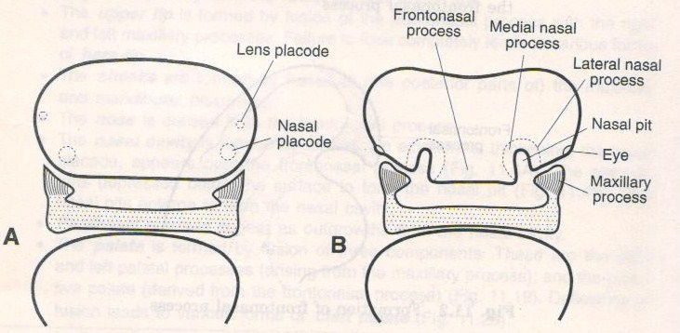
Development of Nose
The ectoderm overlying the fronto-nasal process shows bilateral localized thickenings above the stomodeun known as Nasal placodes

Slide 19
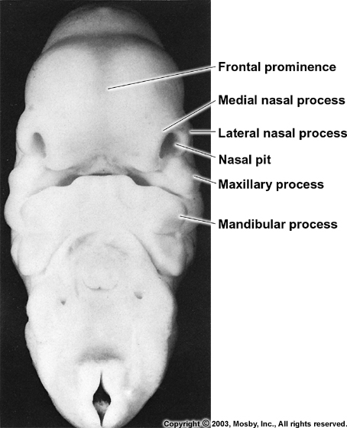

Slide 20
DEVELOPMENT OF LOWER LIP
The right and the left mandibular processes grow towards each other and fuse in the midline to form the Lower lip and Lower jaw.
Mandibular
process

Slide 21
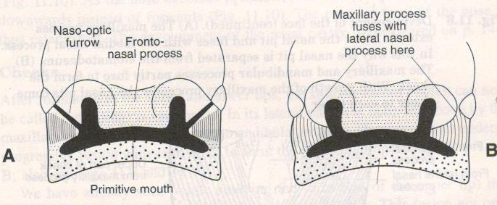
DEVELOPMENT OF THE UPPER LIP
Each maxillary process now grows medially and fuses, first with the lateral nasal process.
The medial and lateral nasal process also fuse with each other. In this way , nasal pits are cut off from the stomodeum.

Slide 22
Development of the Face
Division of
mandibular arch
Formation of
nose

Slide 23
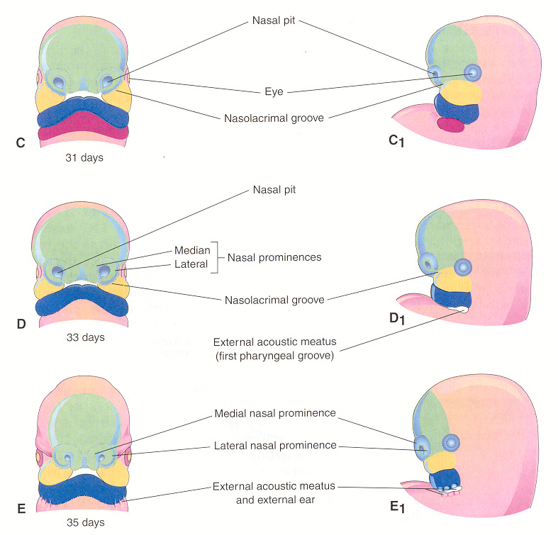
Frontonasal process
Formation of
nose

Slide 24
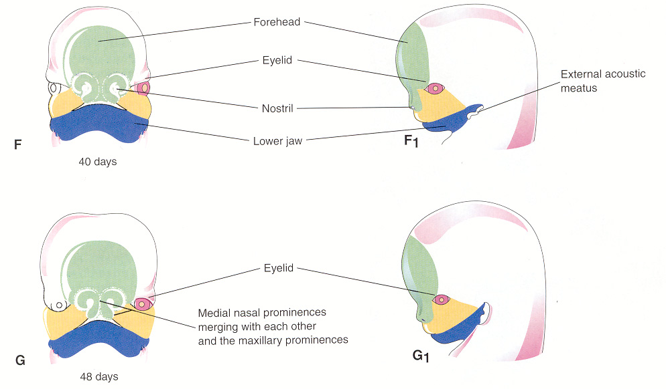
Formation of
cheek

Slide 25
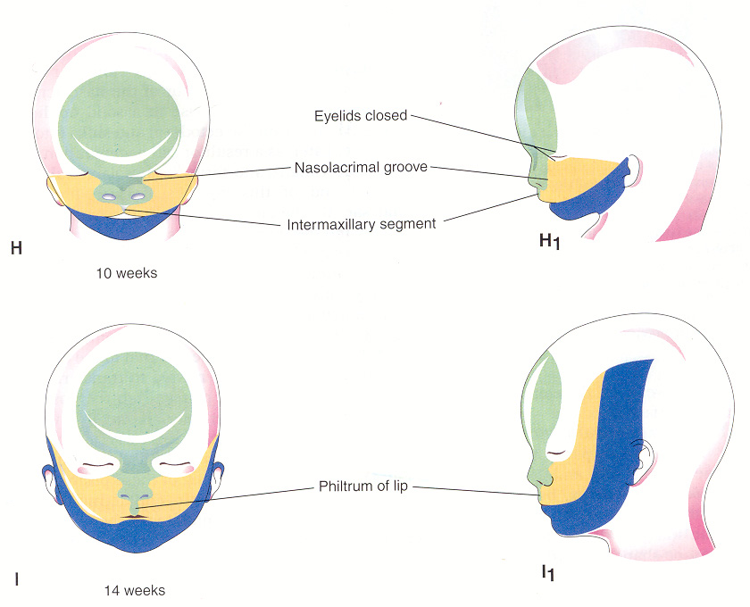
Formation of
Lip

Slide 26
Development of Palate
Palate is a part of maxillary bone which separates the Nasal cavity from the Oral cavity
It lies below the base of nose

Slide 27
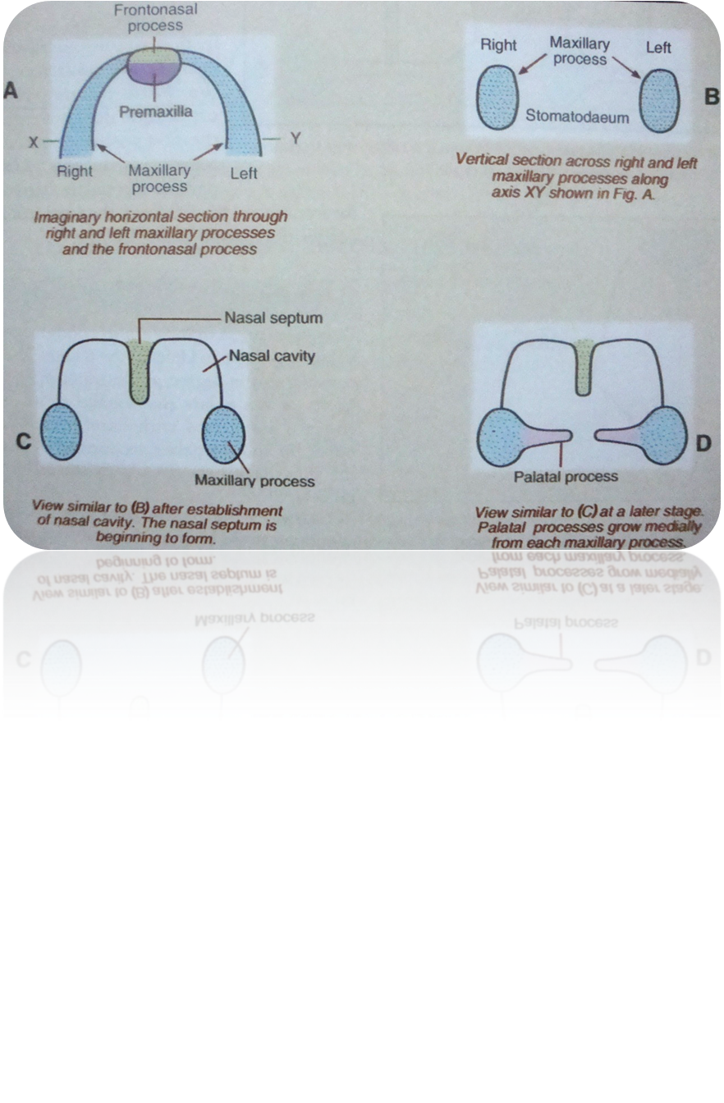
Primitive palate
Fronto-nasal process becomes
Narrow and forms nasal septum
From each maxillary process, a plate –like shelves grows medially, known as palatal shelves
7th week
Notes:
Frontonasal process narows to leave behind nasal septum

Slide 28
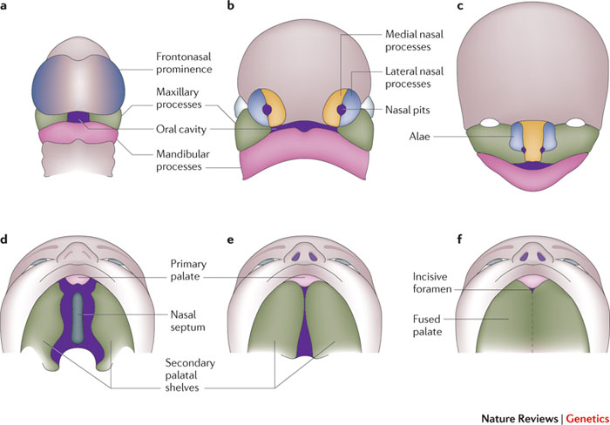

Slide 29
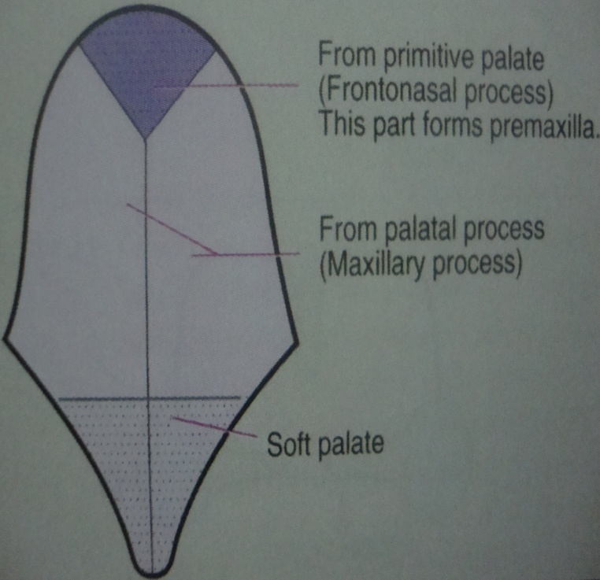
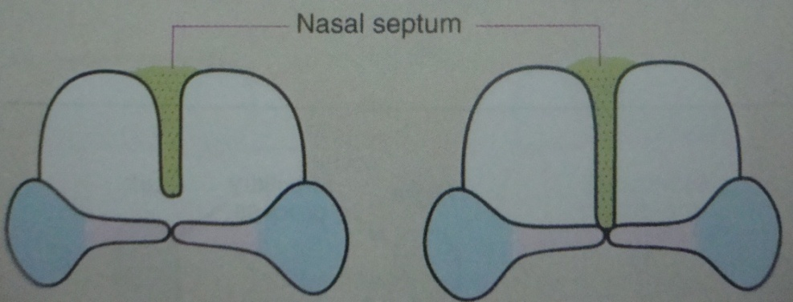
Formation of Secondary Palate
Begins during 7-8 weeks & completes around 3 months
Each palatal process fuses with the primary palate
The two palatal processes fuse with each other in the midline(begins anteriorly and proceeds posteriorly)
The medial edges of the palatal processes fuse with the free lower edge of nasal septum

Slide 30
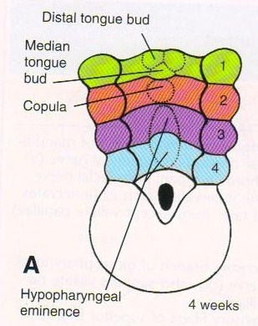
Anterior two-third of the tongue
Tuberculum impar (Median tongue bud)
Lateral lingual Swellings (Distal tongue buds)

Slide 31
Late in 4th week
            Posterior one-third
Midline swelling
‘Copula’
5th & 6th
week
2nd arch
Midline swelling
‘Hypobranchial eminence’
3rd & 4th arch

Slide 32
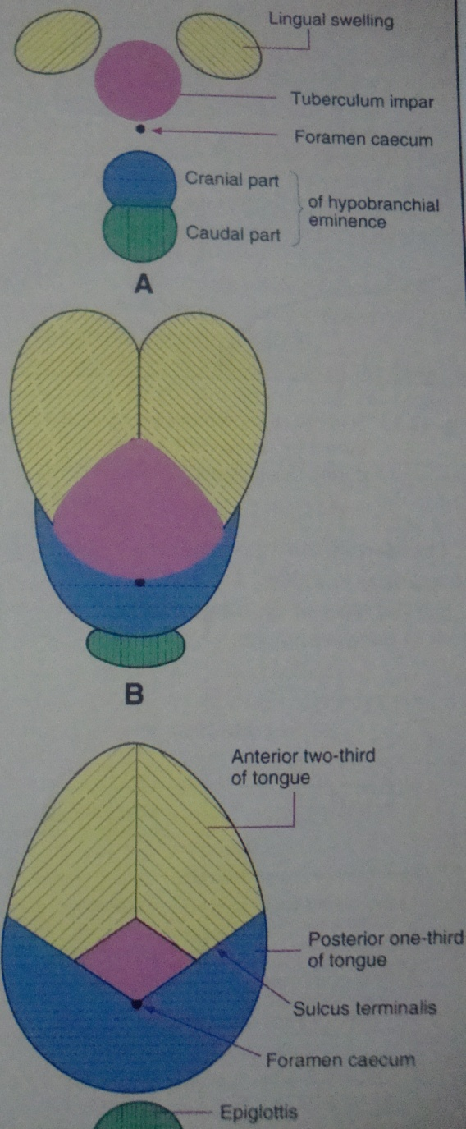
Anterior 2/3rd –
1. Tuberculum impar 2. Two lingual swellings.
Posterior 1/3rd –
1. Cranial part of the hypobranchial eminence.
2. Third arch mesoderm.
Posterior most part- fourth arch
Notes:
The medial – most parts of the mandibular arches proliferate to form two lingual swellings. They are seperated by another swelling in the midline, tuberculum impart. Immediately behind the tuberculum impar, the epithelium proliferates to form a downward growth ( thyroglossal duct) from which the thyroid gland develops. The site of this downward growth is marked by a depression called the foramen caecum.
The 2nd arch mesoderm gets buried below the surface. The 3rd arch mesoderm grows over it to fuse with the mesoderm of the 1st arch .
The boundary between the 1st arch and 3rd arch contributions –roughly, the boundary between the anterior two thirds and posterior one third of tongue-marked by a transverse groove called terminal sulcus .
The line of fusion between the right and left distal tongue buds is marked by a midline groove , median sulcus,on the anterior two thirds of tongue .
32

Slide 33
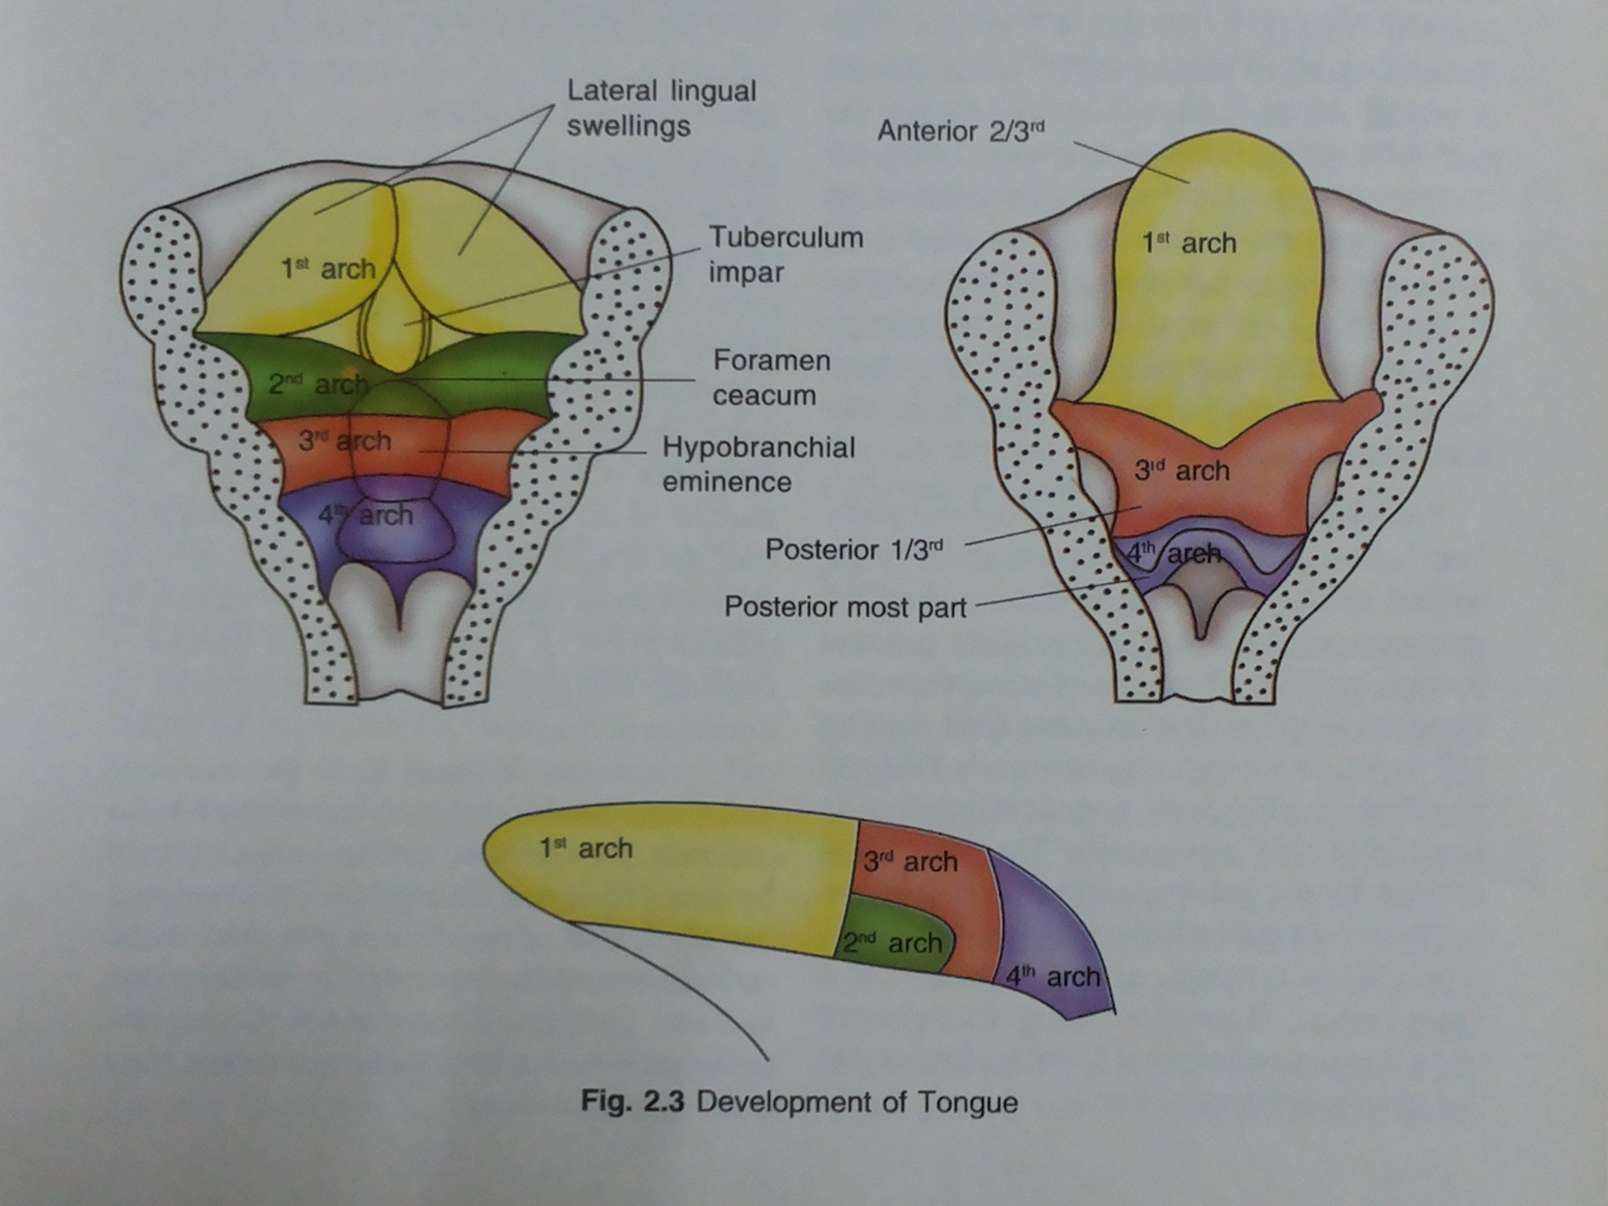

Slide 34
The 2nd arch gets buried below .
The 3rd arch grows over it to fuse with the mesoderm of the 1st arch
The boundary between 1st arch & 3rd arch forms the boundary between the anterior 2/3rd & posterior 1/3rd – “sulcus terminalis”

Slide 36
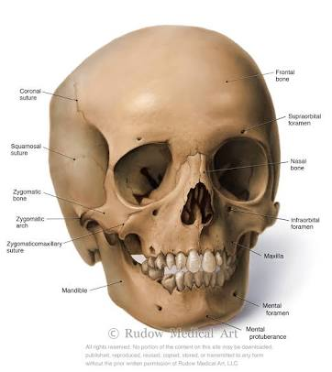
Embryology of maxilla & mandible
Maxilla
Mandible

Slide 37
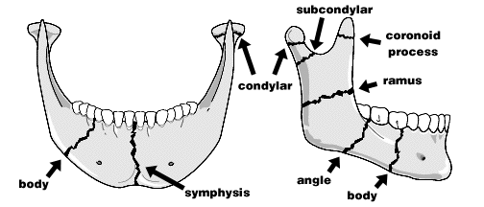

Slide 38
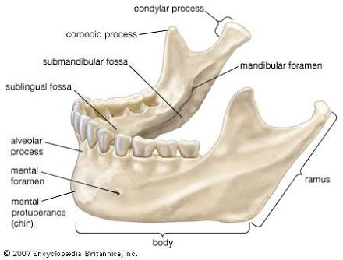

Slide 39
Meckel’s cartilage
Derived from 1st branchial arch (6th week)
Extension : otic capsule to midline/symphysis
Function : provides guiding template for mandible growth
Structures derived :
  mental ossicles
  Incus & malleus
  Spine of sphenoid bone
  Sphenomandibular ligament

Slide 40
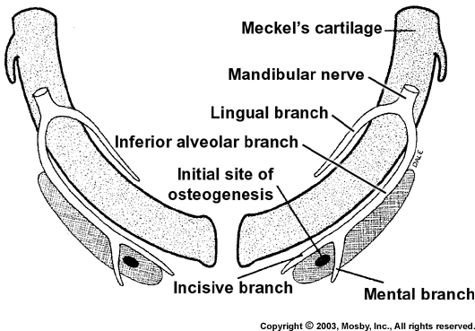
Ossification centres
Location : bifurcation of inferior alveolar nerve into mental and incisive branches

Slide 41
Spread of the ossification continues dorsally and ventrally
↓
Forms the Body and the Ramus of the mandible
↓
As ossification continues
Meckel’s cartilage become surrounded and invaded by bone.
Ossification stops at the site to form the Mandibular lingula

Slide 42
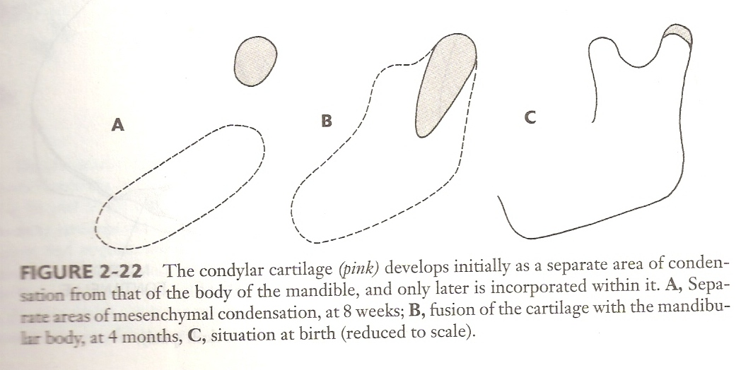
Appears during 7th - 12th week as cone
shaped cartilage
Converted quickly
into bone
by endochondral ossification
Condyle and coronoid
ossifies and fuses with ramus below
Condylar / Coronoid

Slide 43
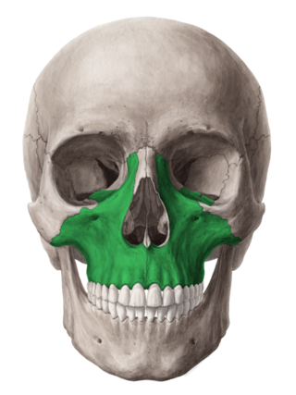
DEVELOPMENT OF MAXILLA
Like mandible, no primary cartilage exists.
Centre of ossification : associated with cartilage of nasal capsule
Ossification centre - bifurcation of inferior orbital nerve

Slide 44
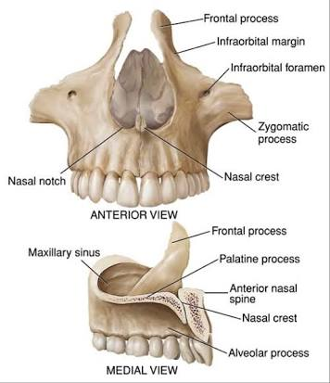

Slide 45
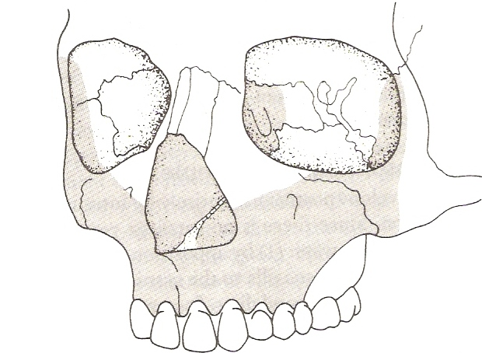
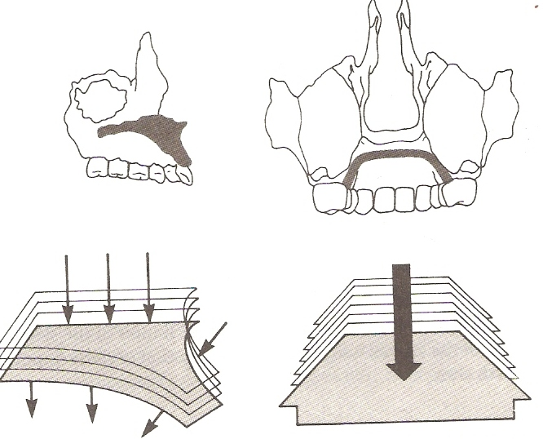
Trough will be formed - accommodate the infraorbital nerve
A downward extension of bone forms the alveolar plate : accommodate the maxillary teeth
Ossification also spreads to palatine processes to form hard palate
Malar / zygomatic cartilage → secondary cartilage : contributes to the development of maxilla

Slide 46
The body of maxilla is relatively small because maxillary sinus has not developed
The sinus forms during the sixteenth week as a shallow groove on the nasal aspect of the developing maxilla
At birth, the sinus is still a rudimentary structure about the size of a small pea

Slide 47
Summary
Embryology is a branch of science that is related to the formation, growth, and development of embryo. It deals with the prenatal stage of development beginning from formation of gametes, fertilization, formation of zygote, development of embryo and fetus to the birth of a new individual.
One of the major goals of embryology research is to better understand congenital malformations, including their causes so that they can be avoided.

Slide 48
Take Home Message
In human 5 pharyngeal arches form on either side of the pharyngeal foregut from day 22.
Each arch contains an cartilaginous supporting element, an aortic arch artery and an arch associated cranial nerve.

Slide 49
Frequently asked questions
Describe in detail about the development of orofacial structures
Neural crest cells
Germ layers
Pharyngeal or Branchial pouches/arches
Development of palate
Development of tounge
Meckel’s cartilage
Development of jaws (maxilla & mandible)

Slide 50
References
SN Bhaskar . Orban’s ,Oral Histology and embryology. 11th edition, Mosby 1998
Neville BW ,Damm DD ,Allen CM ,Bouquot JE . Oral and maxillofacial pathology , 2nd Edition .Philadelphia W.B. Saunders ;2002
Richard Tencate , Oral Histology development ,structure and function . 5th Edition ,1998
Carranza F.A., Michael G. Newman . Clinical periodontology 8,9,10th edition

Slide 51
THANKYOU

